Slide 1
SEGMENTED BAR CHART
HARINI K V-21PD10
HARISH R-21PD11

Slide 2
INTRODUCTION TO CHART
01
02
03
A Segmented Bar Chart is a type of chart that uses segmented bars to help us visualize categorical data.
A segmented Bar chart is one kind of stacked bar chart, but each bar will show 100% of the discrete value
This helps us to visualize how larger category is divided into smaller sub-categories and their relationship to the aggregate value

Slide 3
UNDERSTANDING THE PROBLEM
DATASET
SOLUTION
Dataset is regarding “Quarterly Sales Analysis” of certain things like notepad, pencil, whitener in 4 cities of America like Houston, Los Angeles , Chicago, New York
Visualization of quarterly sales analysis using segmented bar chart

Slide 4
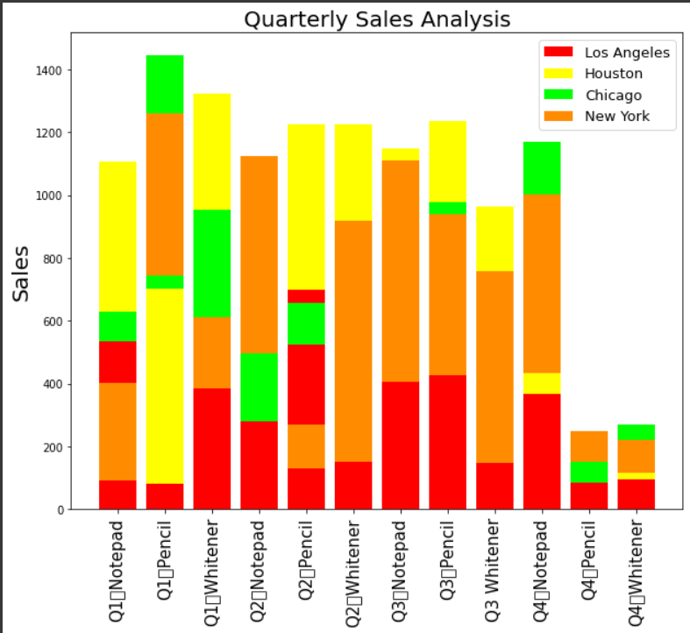
VISUALIZATION
Insights:
The worst-performing location was Chicago
Notepad had made a good sales in city of New York in Q3
Whitener sales in city of Houston in Q4,Q3 is comparatively less when compared to it sales in Q1, Q2
Pencil sales in city of Los Angeles in Q1,Q4 is less in contrast with sales of other products in this city

Slide 5
CONCLUSION
If your dataset includes multiple categorical variables, bar charts can help you understand the relationship between them.
Segmented bar graphs are often used to compare data between other groups.

Slide 6
THANK YOU

